Slide 1


Predicting Cardiovascular Disease A machine learning approach
STAT5003 - Group 23
Presented by:
Fred Najjar, Haseeb Munir, Johnathan Mc Donogh, Kai Wang, Mary Huang, Sanket Srivastava
20 seconds

Slide 2
AGENDA
AGENDA
Agenda
Summary
Background Introduction
Data collection &Exploration
Pre-processing & Challenge
Modeling & Evaluation
Key Finding & Conclusion
Q&A
20 seconds

Slide 3






Background Introduction
Process Flow
Acquire Dataset
Iterate
Analyse Dataset
Pre-Processing
Data Modelling
Evaluation
Best Model
Review Data Description
Data Exploration
Distribution Analysis
Correlation Analysis
Feature Selection
NA Removal Strategy
Re-Sampling Strategy
Feature Elimination
Feature Engineering
Logistic Regression
Decision Tree
Random Forest
XGBoost
Cross-validation
Hyperparameter Tuning
Specificity Score
Sensitivity Score
Model Evaluation
Summary
20 seconds

Slide 4
Data Collection
Data Source
Overview of dataset
Importance of dataset
Supervised classification problem
DATASET DESCRIPTION
20 seconds
Notes:
Cardiovascular disease (CVD)- the leading cause of death around the globe
CVD is accountable 16% of the world’s total number of deaths and increasing more than 20% from 2019 to 2020 (WHO 2019)
Centers for Disease Control and Prevention (CDC) Heart disease survey
studying the leading indicators of CVD to reduce the death rate
supervised binary classification problem

Slide 5

Data Collection
Overview of Prediction Problem
Missingness in data
High Dimensional features
Imbalanced dataset
20 seconds

Slide 6
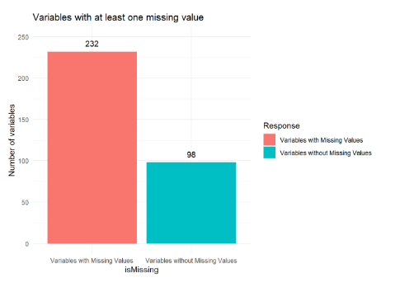
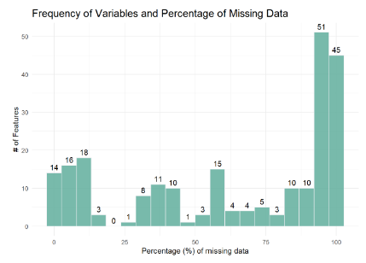
Large & Missing Data
Data Exploration
440K+ survey samples
70% of the features contains na value
36% of the total number of features have more than 75% NAs
20 seconds

Slide 7
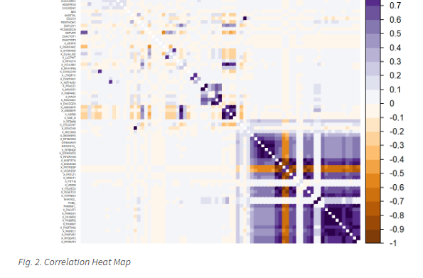
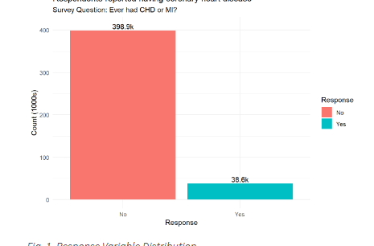
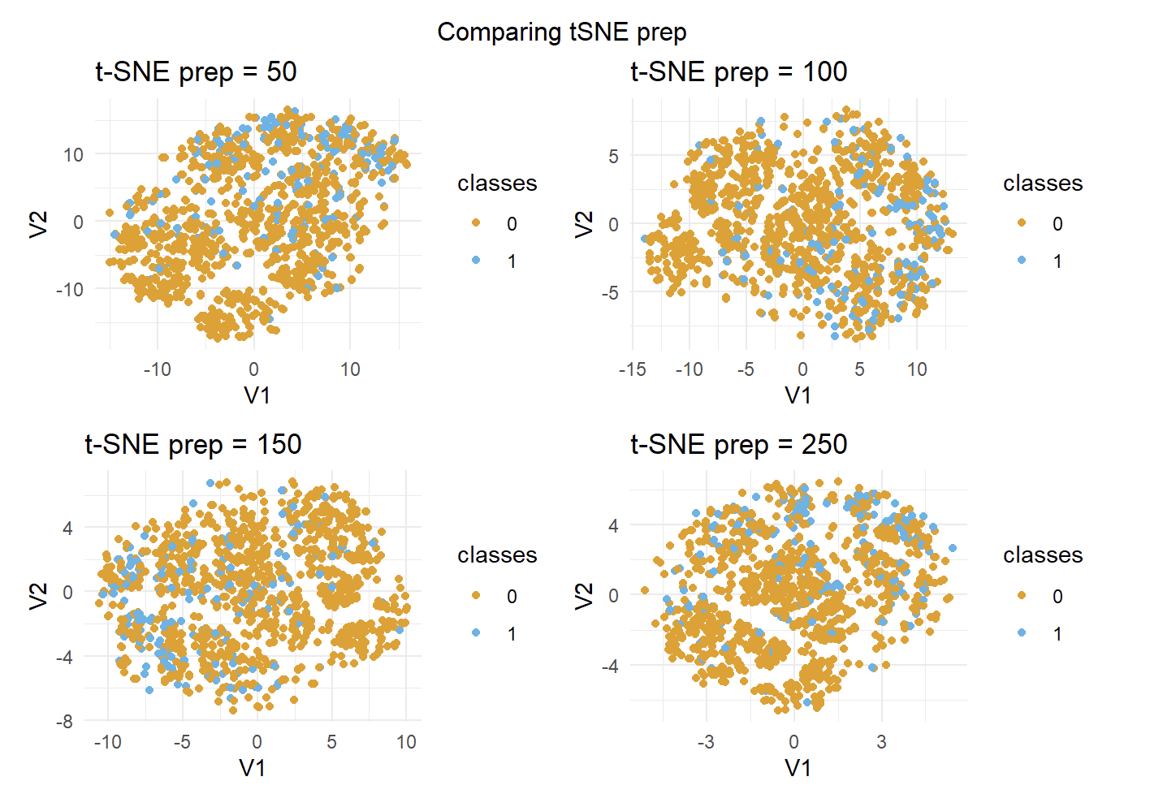
Imbalanced & high dimension
Data Exploration
Issue of multicollinearity (Fig. 2) - must be considered to ensure the accuracy of the fitted models
Correlation analysis
Data distribution
330+ features
T-SNE – No separation between the classes
20 seconds

Slide 8
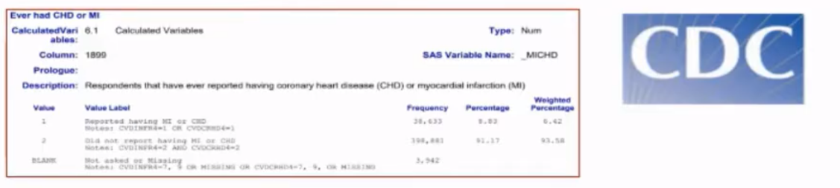
Large & Missing Data
Data Pre-Processing
CDC Codebook
Chose 23 Features
Convert Numerical to Categorical
Survey respondents with ‘Not Answered’ converted to NA
Important Features
HeartDiseaseorAttack
HighBP
HighChol
BMI
Smoker
Stroke
Diabetes
PhysActivity
Fruits
Veggies
HeavyAlcoholConsumption
AnyHealthcare
NoDocbcCost
GenHlth
MentHlth
PhysHlth
DiffWalk
Sex
AgeGroup
Education
Income
20 seconds

Slide 9
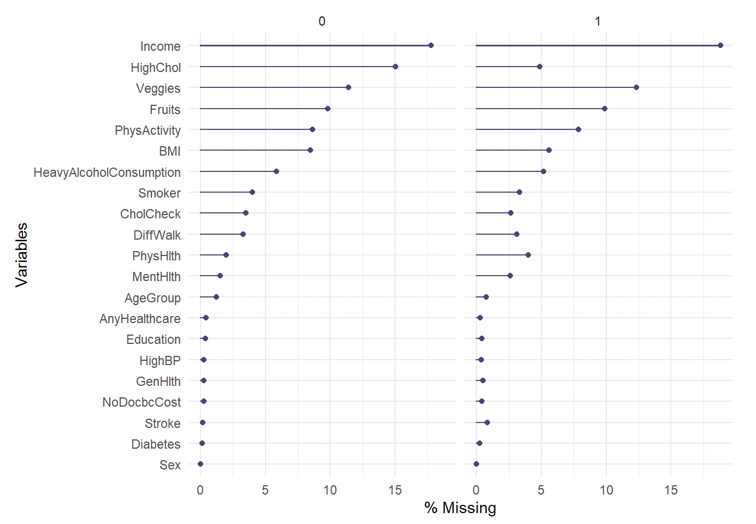
Large & Missing Data
Data Pre-Processing
Missingness in shortlisted variables
NaN Removal
20 seconds

Slide 10
Large & Missing Data
Data Pre-Processing
Normalized Data
One – Hot Encoding
20 seconds

Slide 11
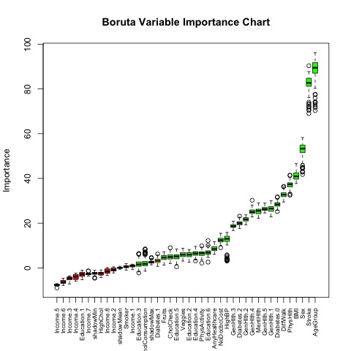
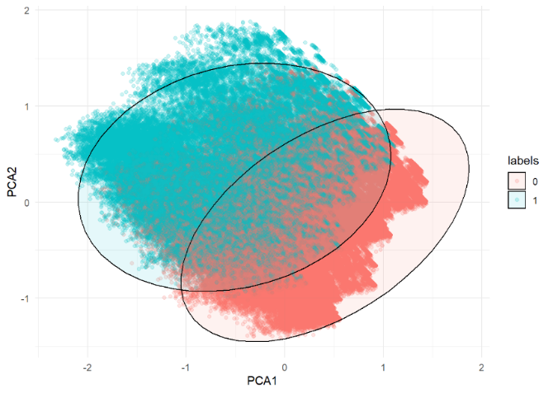
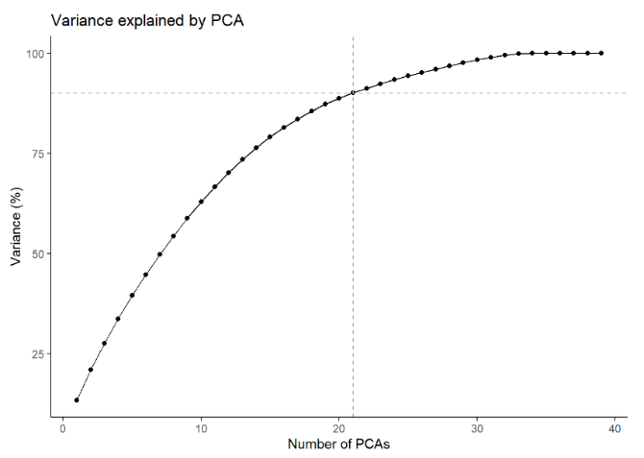
High Dimension
Data Pre-Processing
PCA
21 Variables explain 90% of variance
Lot of overlap - PCA not too useful
Recursive feature elimination
20 seconds
Notes:
Forward Selection
Start with having no feature. Keep adding the feature which best improves the model till an addition of a new variable does not improve the performance of the model
Backward selection
Start with all the features and removes the least significant feature at each iteration
Recursive feature elimination:
A greedy optimization algorithm which amins to find the best performing feature subset

Slide 12
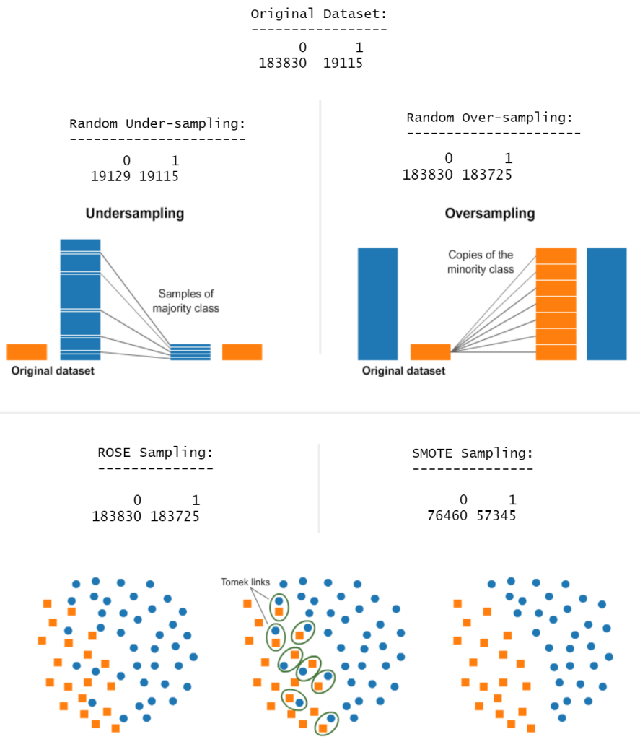
Imbalanced Data
Data Pre-Processing
Undersampling
Informative
Random
Oversampling
Informative
Random
Synthetic data generation
ROSE and SMOTE
20 seconds
Notes:
Undersampling:
This method reduces the number of observations from majority class to make the data set balanced. This method is best to use when the data set is huge and reducing the number of training samples helps to improve run time and storage troubles.
Undersampling methods are of 2 types: Random and Informative.
Random undersampling method randomly chooses observations from majority class which are eliminated until the data set gets balanced. Informative undersampling follows a pre-specified selection criterion to remove the observations from majority class.
A possible problem with this method is that removing observations may cause the training data to lose important information pertaining to majority class.
Oversampling:
This method works with minority class. It replicates the observations from minority class to balance the data. Similar to undersampling, this method also can be divided into two types: Random Oversampling and Informative Oversampling.
Random oversampling balances the data by randomly oversampling the minority class. Informative oversampling uses a pre-specified criterion and synthetically generates minority class observations.
An advantage of using this method is that it leads to no information loss. The disadvantage of using this method is that, since oversampling simply adds replicated observations in original data set, it ends up adding multiple observations of several types, thus make the model more likely to overfit.
Synthetic Data Generation (SMOTE and ROSE)
In simple words, instead of replicating and adding the observations from the minority class, it overcome imbalances by generates artificial data. It is also a type of oversampling technique.
In regards to synthetic data generation, synthetic minority oversampling technique (SMOTE) is a powerful and widely used method. SMOTE algorithm draws artificial samples by choosing points that lie on the line connecting the rare observation to one of its nearest neighbors in the feature space. ROSE (random over-sampling examples) uses smoothed bootstrapping to draw artificial samples from the feature space neighbourhood around the minority class.
The modeling approach taking will involve training all classifiers on the train set with class imbalance suitably altered using each of the techniques above. The chosen model will be based on which technique and model yields the best ROC-AUC score on a holdout test set.

Slide 13





AGENDA
Modeling
Modelling
Execution Strategy
Execution Flow
Sampling
Classifiers
Evaluation
Under sampling
Logistic Regression
Test
Over sampling
Decision Tree
AUC
Sensitivity
/20%
ROSE
Random Forest
Training
Cross-Validation
Specificity
/80%
SMOTE
xGBoost
x10-Folds
Feat. Reduction
Grid Search
20 seconds
Notes:
We used 80% of the dataset to fit and tune all of our classification models combined with the different sampling strategies, then used the last 20% to evaluate the models’ accuracy and applied 10fold cross-validation on all models and focused on the sensitivity and specificity scores to pick our best model

Slide 14
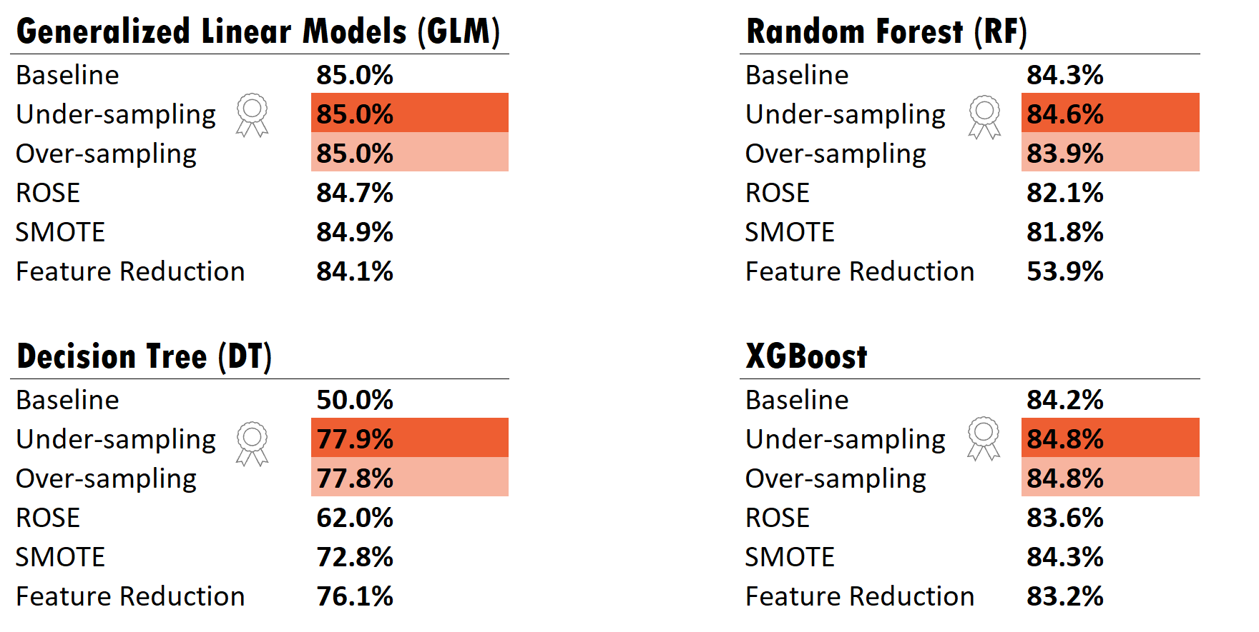
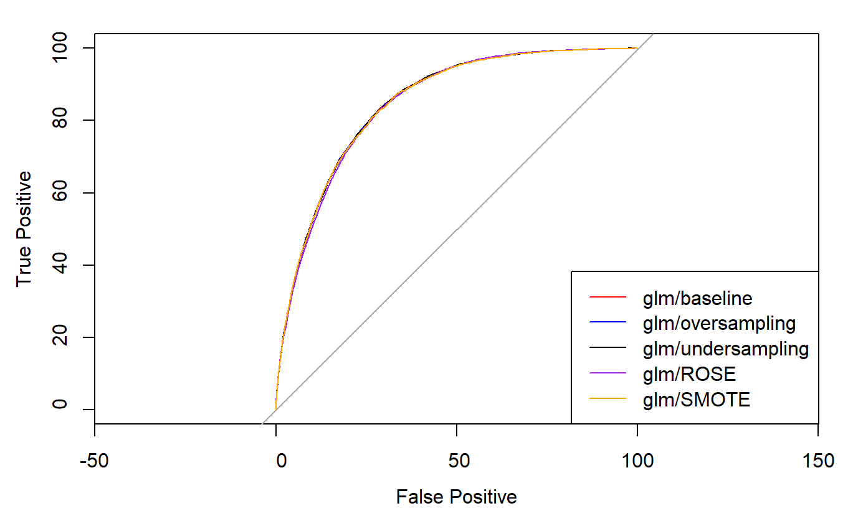
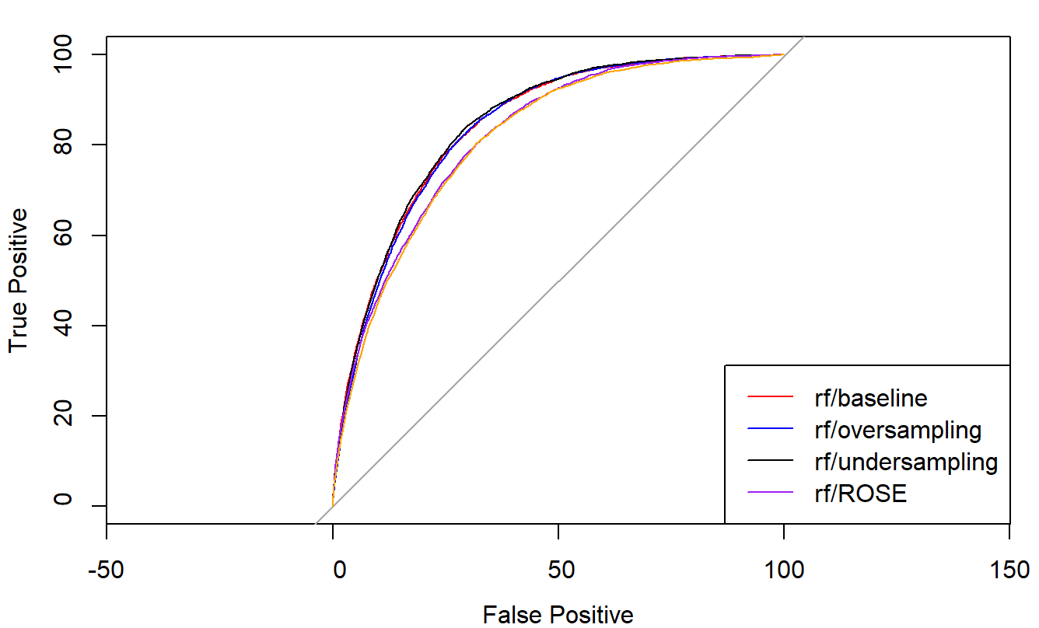
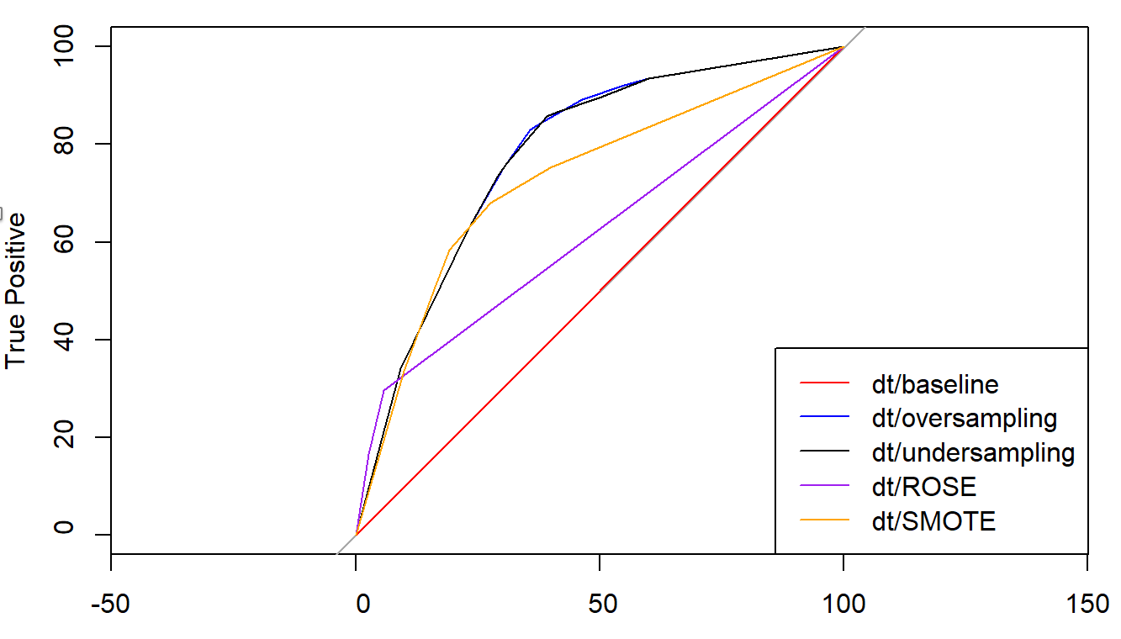
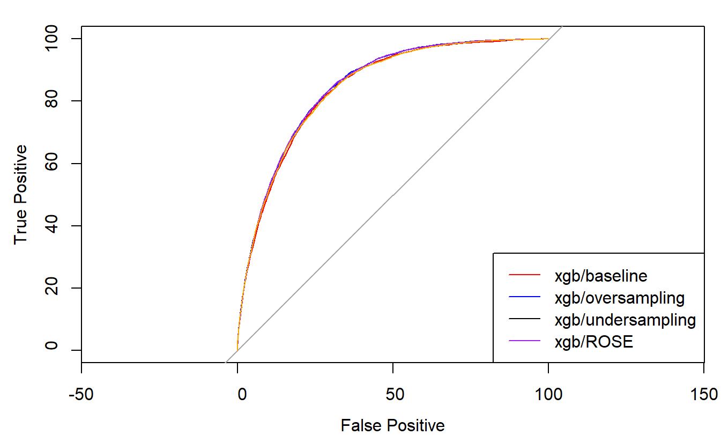
Results for GLM – Logistic Regression
Evaluation
Evaluation
Classification Models AUC Score
20 seconds
Notes:
All models had a higher AUC score with under and oversampling techniques

Slide 15
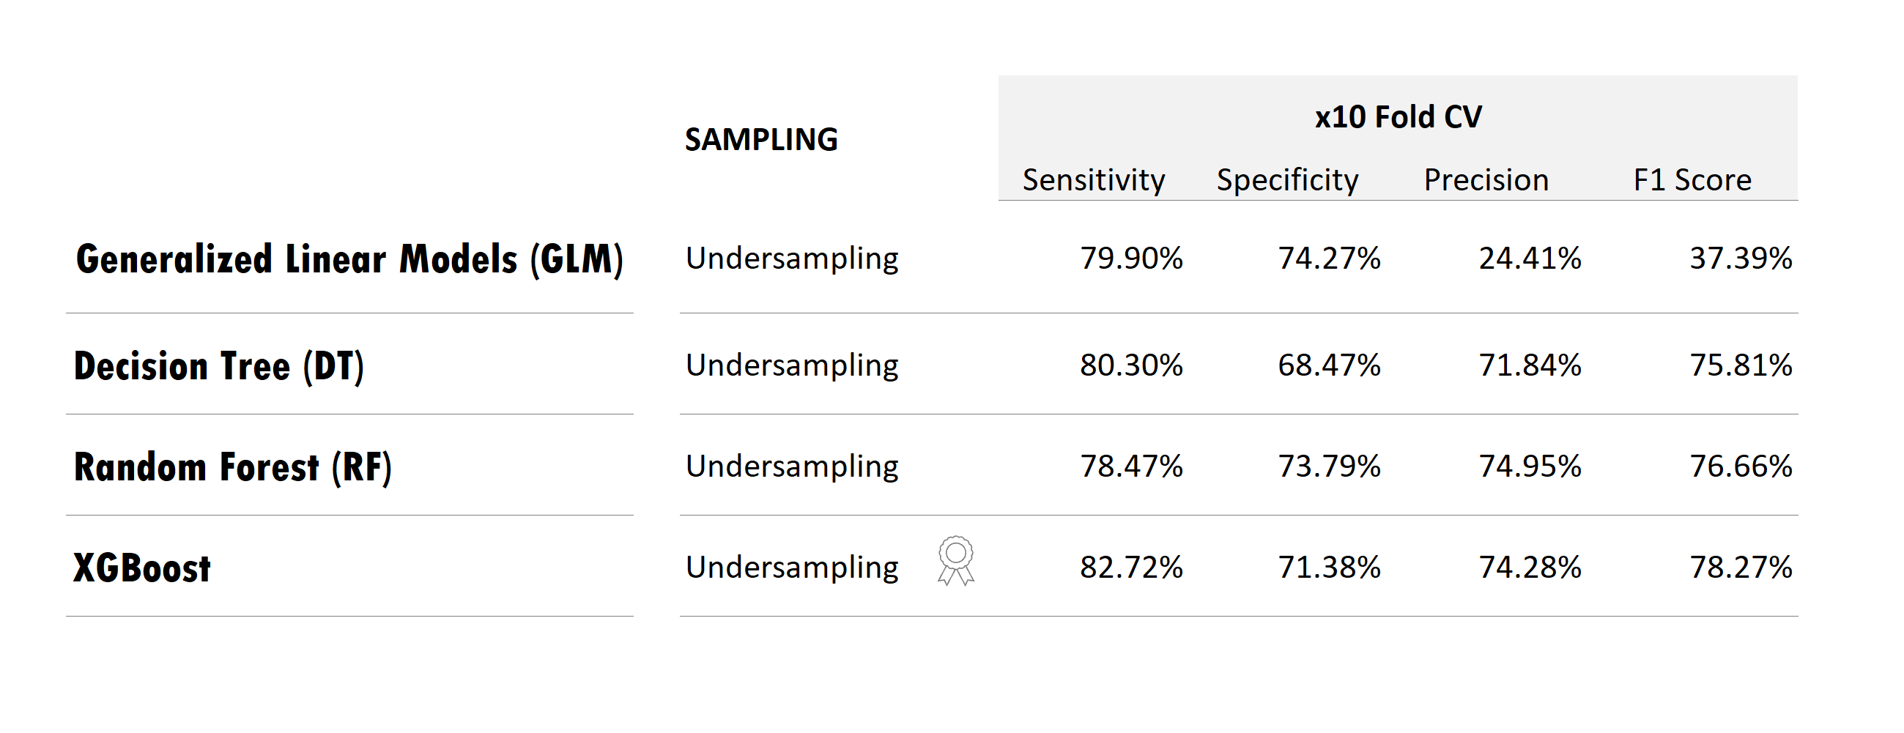
AGENDA
Modeling
Modelling
Evaluation 10-Fold Cross-Validation
Execution Flow
20 seconds
Notes:
We used 80% of the dataset to fit and tune all of our classification models combined with the different sampling strategies, then used the last 20% to evaluate the models’ accuracy and applied 10fold cross-validation on all models and focused on the sensitivity and specificity scores to pick our best model

Slide 16
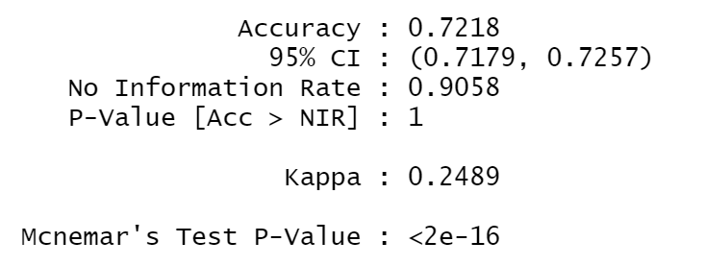
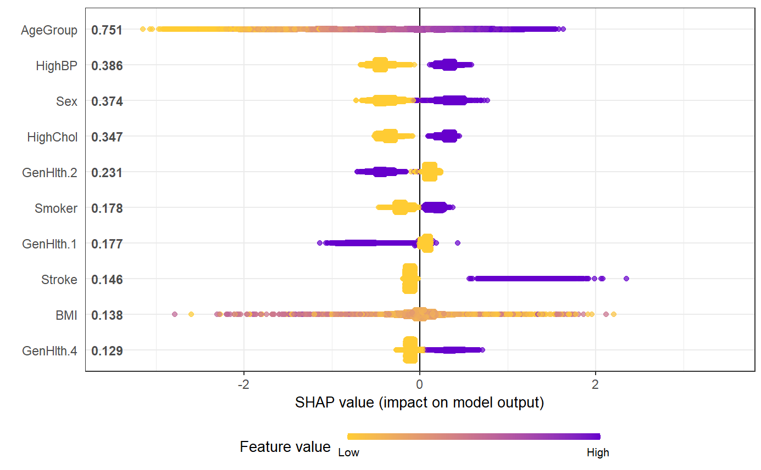
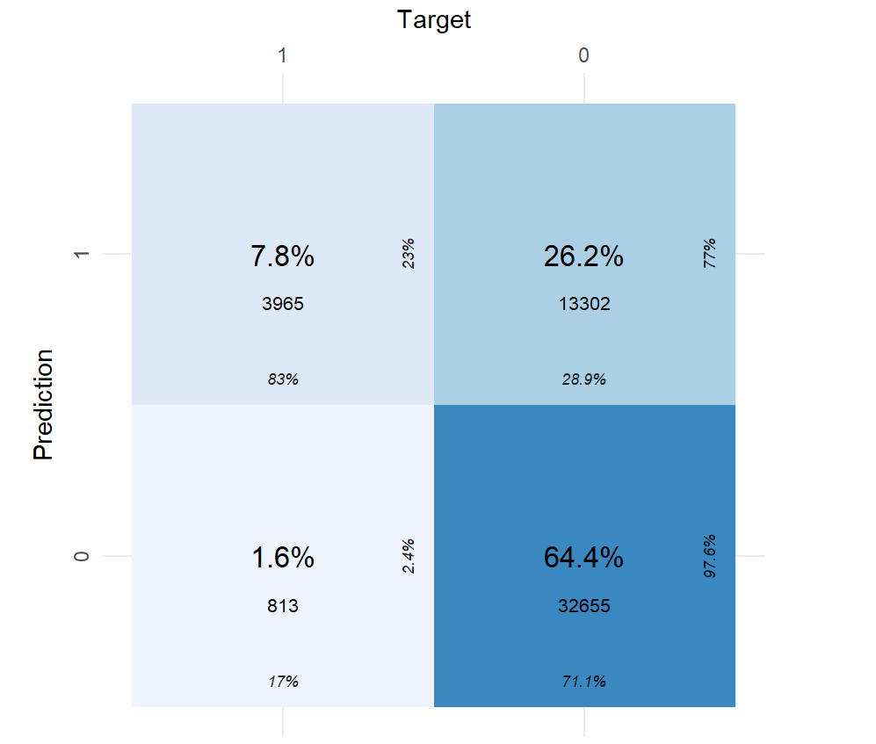
AGENDA
Modeling
Modelling
xGBoost Features Important
Execution Flow
20 seconds
Notes:
Surprisingly – stroke and diabetes are not amongst the top predictors
SHapley Additive exPlanations
Each point represents a row from the original dataset.
The y-axis indicates the variable name, in order of importance from top to bottom. The value next to them is the mean value.
the value On the x-axis Indicates how much the change contributes to the probability of success, in log-odds.
Gradient colour indicates the original value for that variable. Boolean values will have two colour, while continues values are assigned the whole spectrum

Slide 17
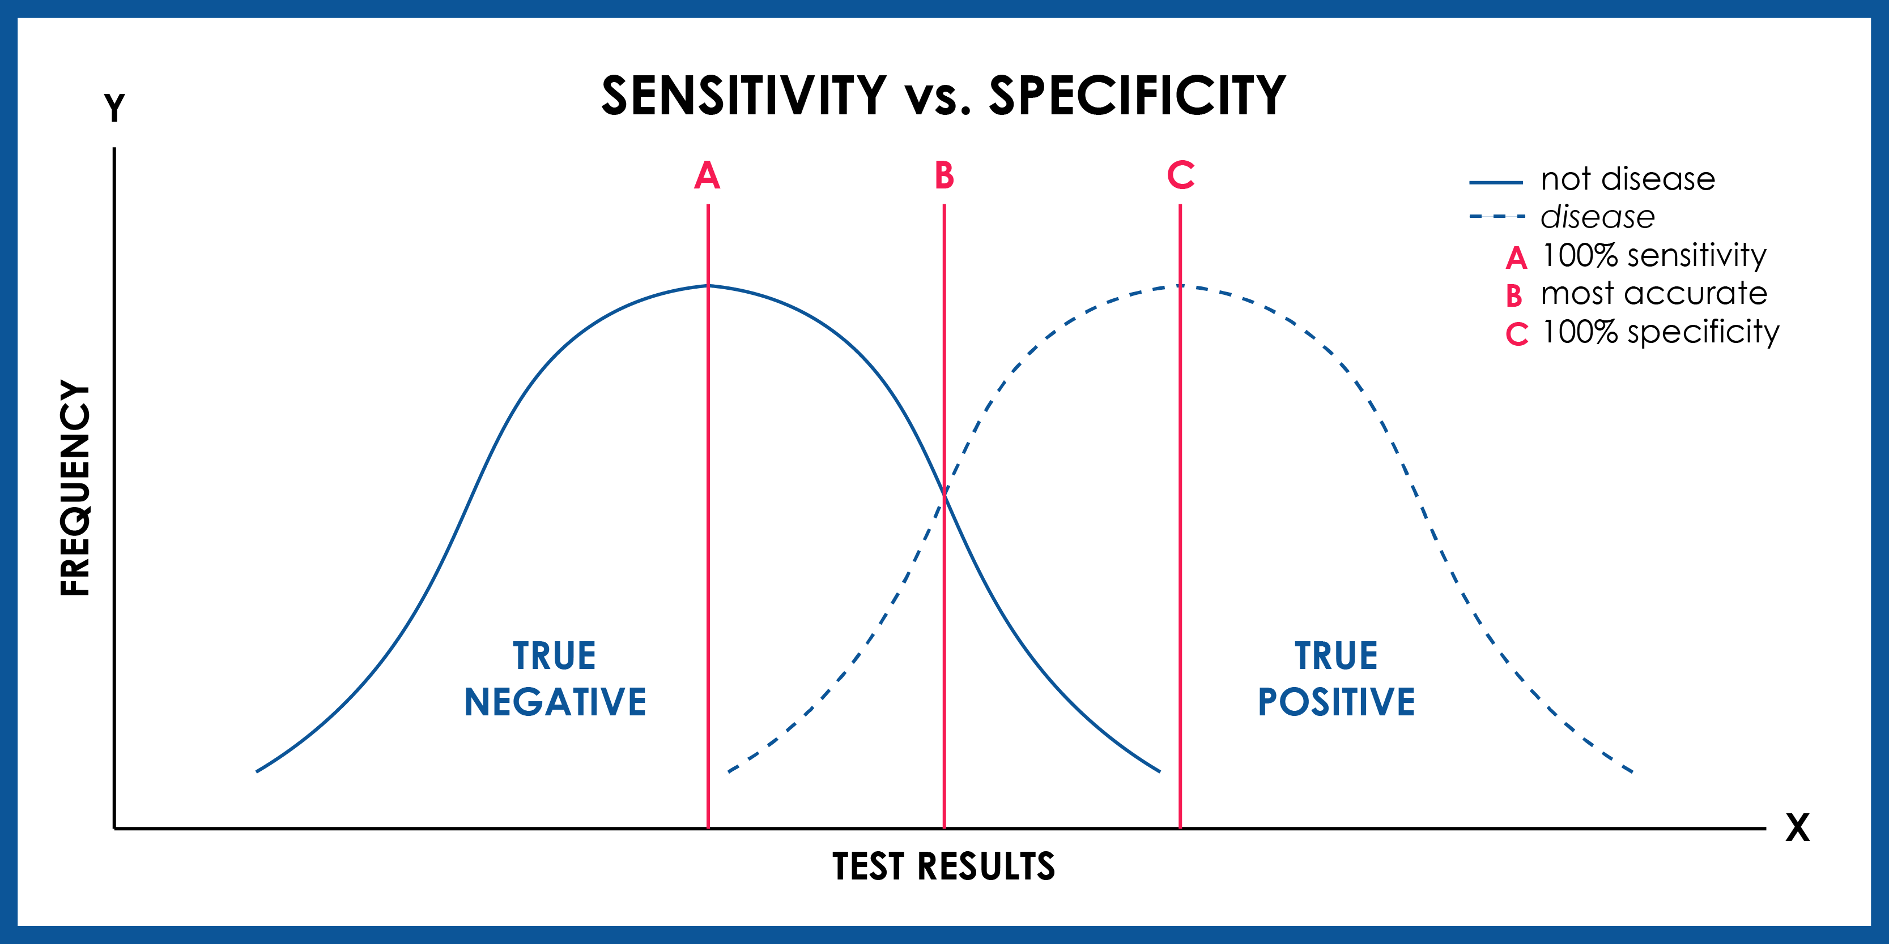
Conclusion
Conclusion / Key Findings
Most important metrics → Sensitivity & Specificity
Sensitivity → True Positive Rate
Specificity → True Negative Rate
Sensitivity over Specificity
Accuracy → Not the best evaluation metric
Decision Tree & XGBoost → high sensitivity & specificity
20 seconds

Slide 18
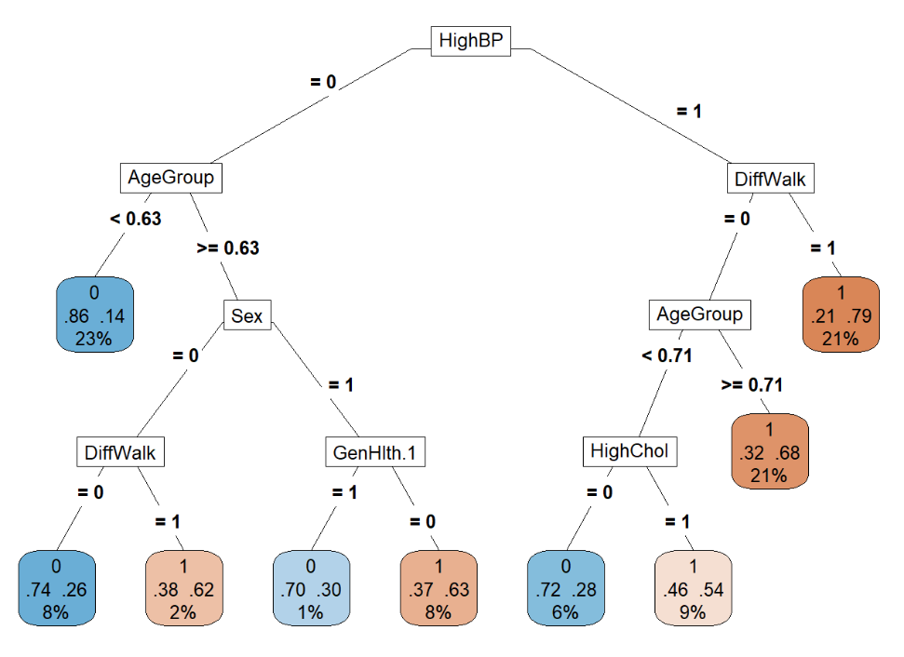
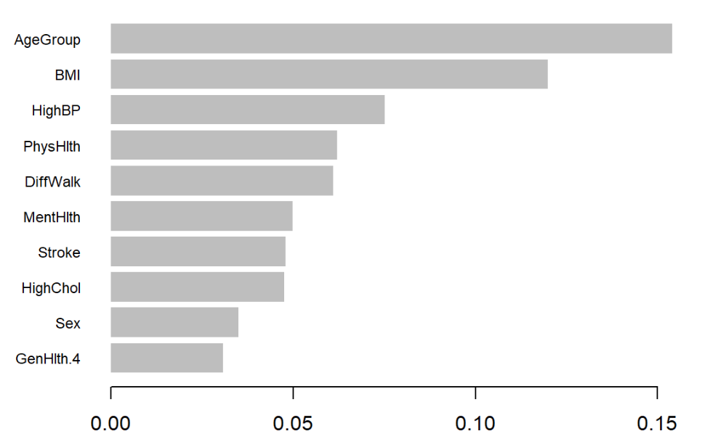
Key Findings
Conclusion / Key Findings
Overlapping Predictors of Decision Tree & XGBoost
Most Important Predictors for CVD:
High Blood Pressure
High Cholesterol
Difficulty Walking
General Health
Age
Sex
20 seconds

